Slide 1
Classification of Matter

Slide 2
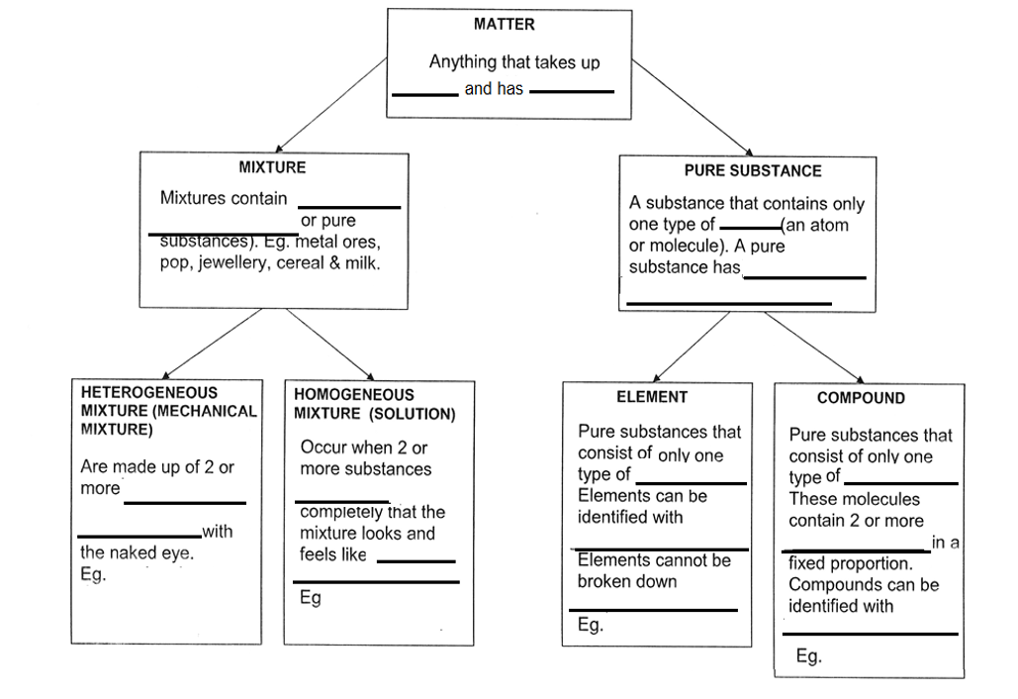

Slide 3
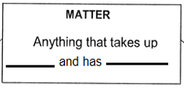
space
mass

Slide 5
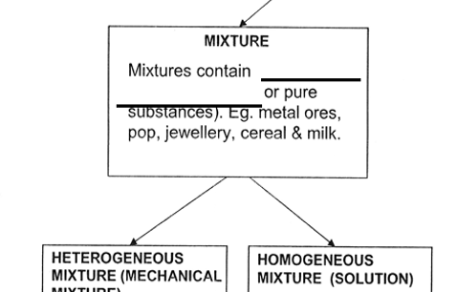
at least TWO
Kinds of particles

Slide 6
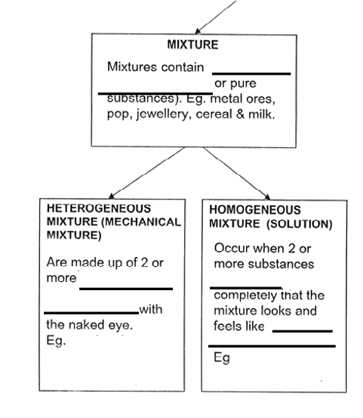
At least TWO
Kinds of particles
different parts
mix
visible
one
substance
sand and water
salt and water
oil and water
steel (iron and carbon)

Slide 8
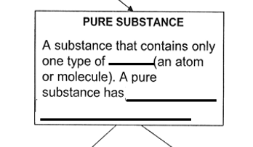
particle
constant properties

Slide 9
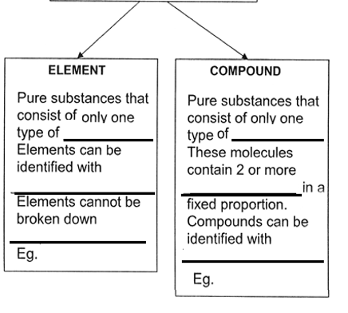
Pure Substances
atom
molecule
chemical symbols
elements
further
C, Mg, S, O₂
Chemical formulas
NaCl, H₂O

